Slide 1
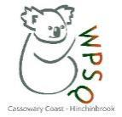
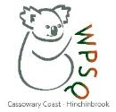
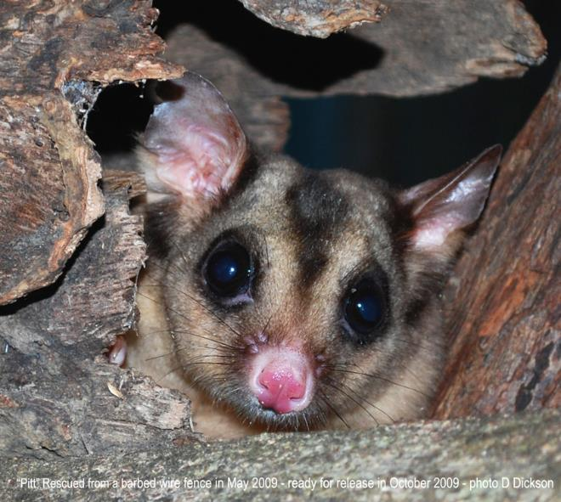
Connecting and protecting Queensland’s endangered mahogany glider
July 2020
Daryl Dickson
conservationist | wildlife artist
President Cassowary Coast-Hinchinbrook Branch of Wildlife Queensland

Slide 2
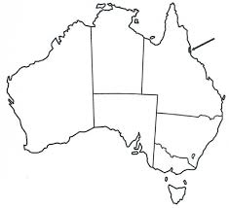
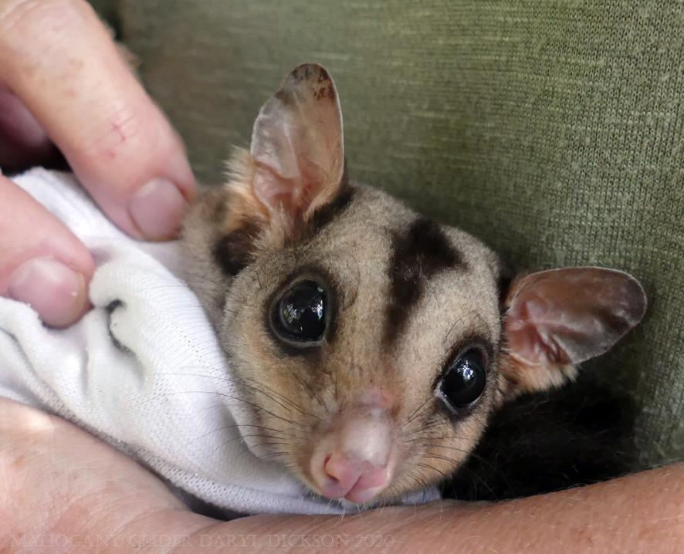
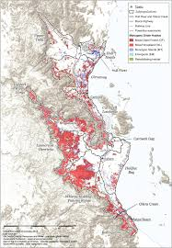
Meet the endangered mahogany glider
Creator: Stephen M. Jackson,Mark Parsons, Marcus Baseler and David Stanton

Slide 3
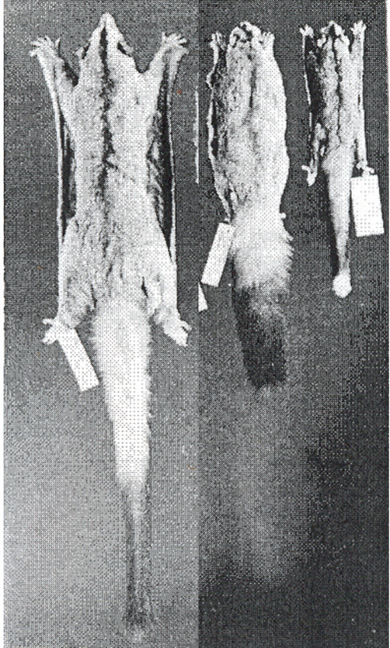
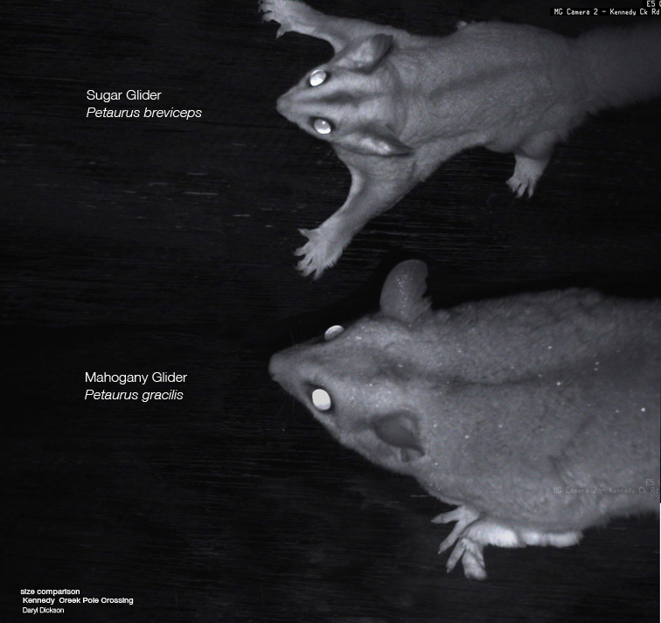
What makes them different from sugar and squirrel gliders?

Slide 4
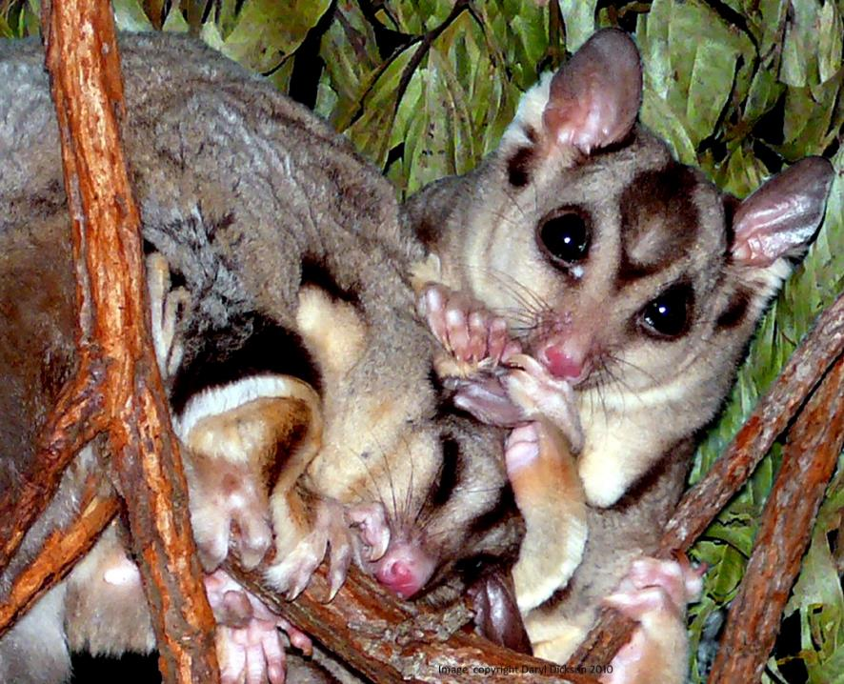
Den Partners
Pair for life
Defend a territory of about 20 hectare
Use up to 10 different dens
Both help care, protect & raise den young

Slide 5
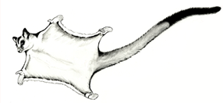
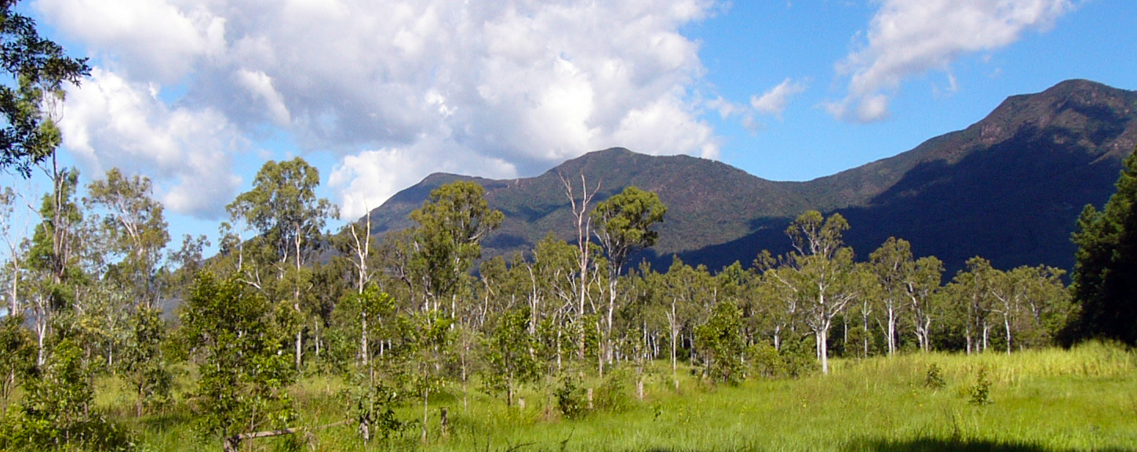
open tropical coastal woodland
Habitat: eucalypt – grass trees – melaleuca
Distribution – coastal far north tropics, between the Hull River in the North to Ollera Creek in the south.

Slide 6
coastal wetland - melaleuca

Slide 7
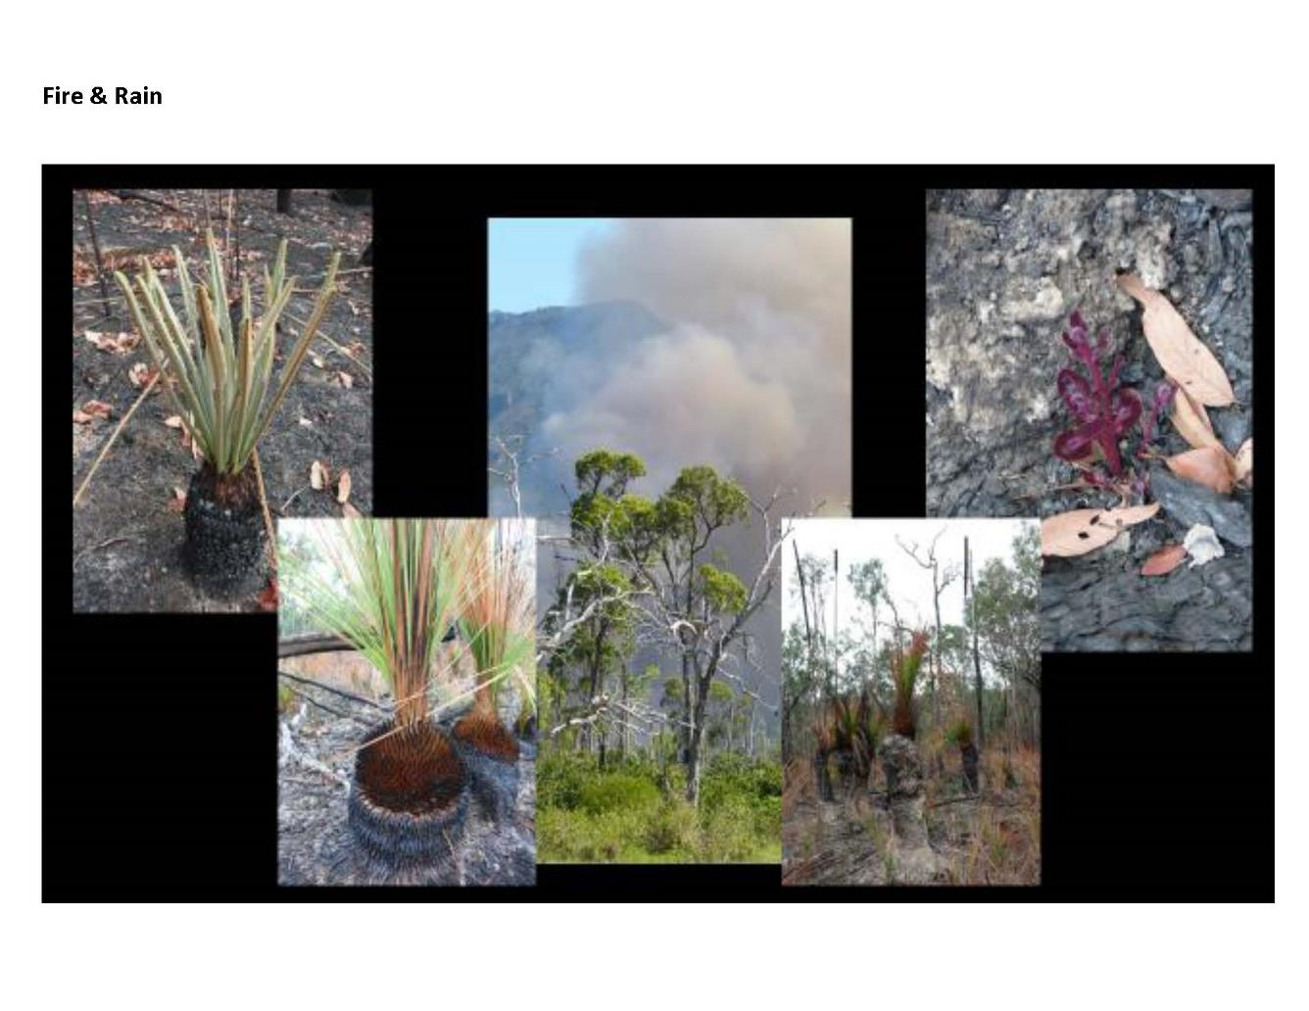
Fire and rain habitat

Slide 8
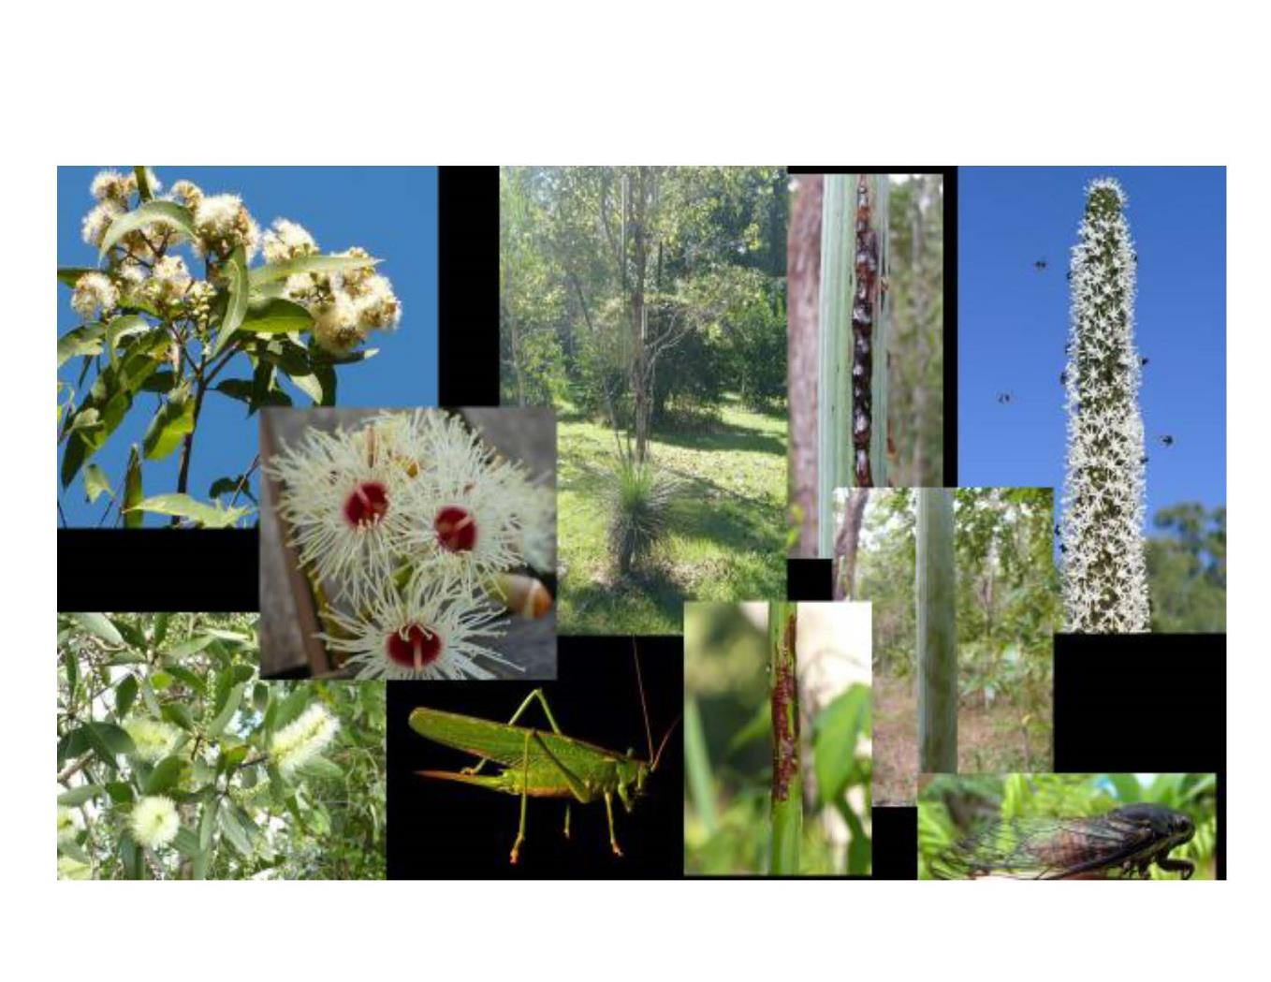
Food sources

Slide 9
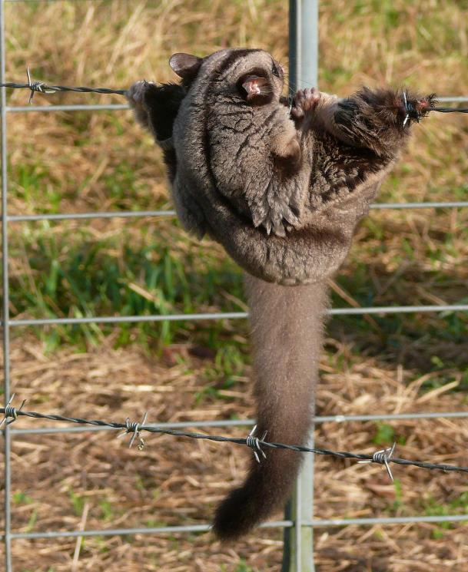
Main threats to mahogany gliders
Habitat loss, ongoing decline of extent and quality
Connectivity – landscape linkage
Inappropriate fire regimes
Barbed wire fences
Extreme climatic events
Climate change

Slide 10
Working to overcome fragmentation in threatened species habitat
Glenbora - Bairds Creek Mahogany Glider Corridor Project Qld Govt Everyone’s Environment Grant
Working with graziers in the west & south of the Kennedy Valley – wildlife-friendly fencing, planting paddock trees and corridor restoration
Bridging the Gap Project Wildlife Qld Public Fund Raiser
Glider poles – link corridor project to the south with cassowary habitat to the north
Camera monitoring images show use of poles

Slide 11
Working to overcome fragmentation in threatened species habitat
Whitfield Creek Corridor
Working with plantation managers in the north of the Kennedy Valley – corridor restoration, fire planning and weed control
Wildlife Queensland Townsville Ollera Creek Mahogany Glider and Landscape Project
Working to assist recovery team partners with projects where we can – Terrain NRM Woodland Project Aust Govt National Landcare Woodlands Project

Slide 12
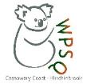
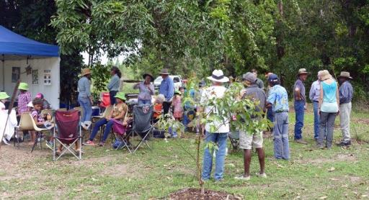
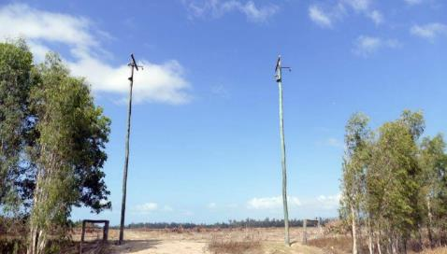
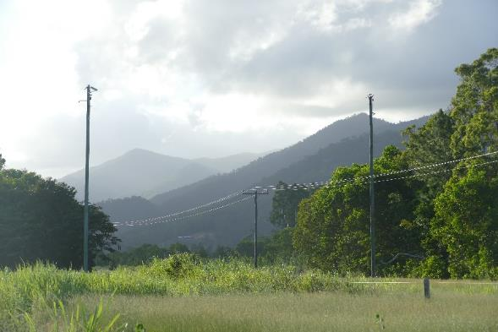
Projects
Bridging the Gaps
Linking isolated habitat and restoring corridors

Slide 13
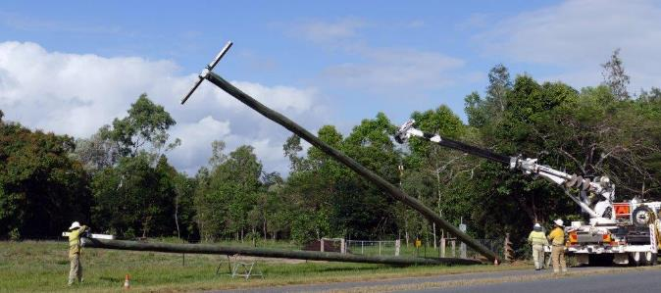
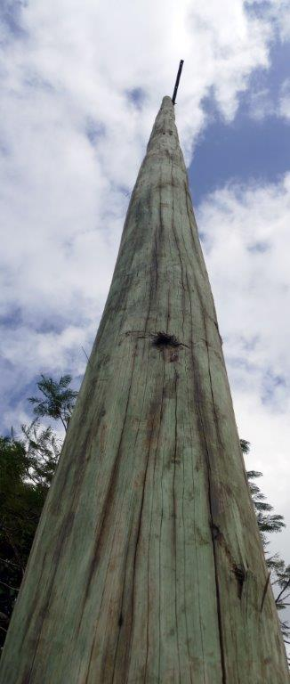
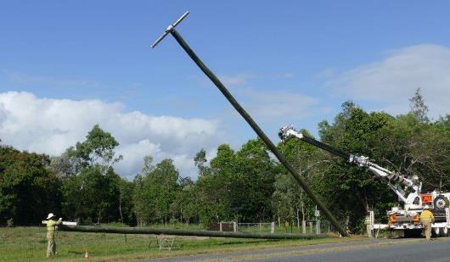
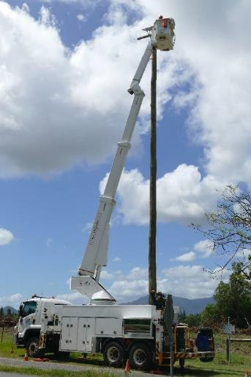
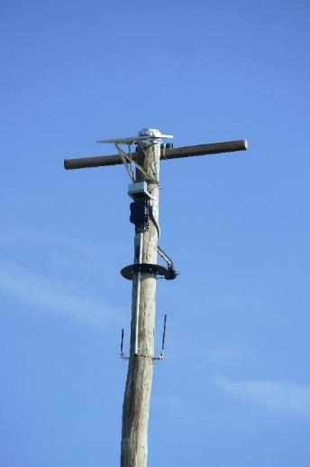
Glider Poles + 3G camera monitoring

Slide 14
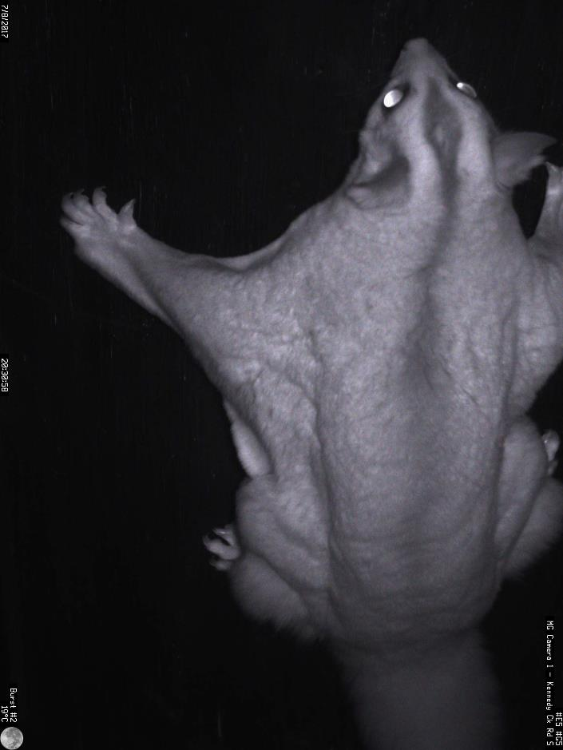
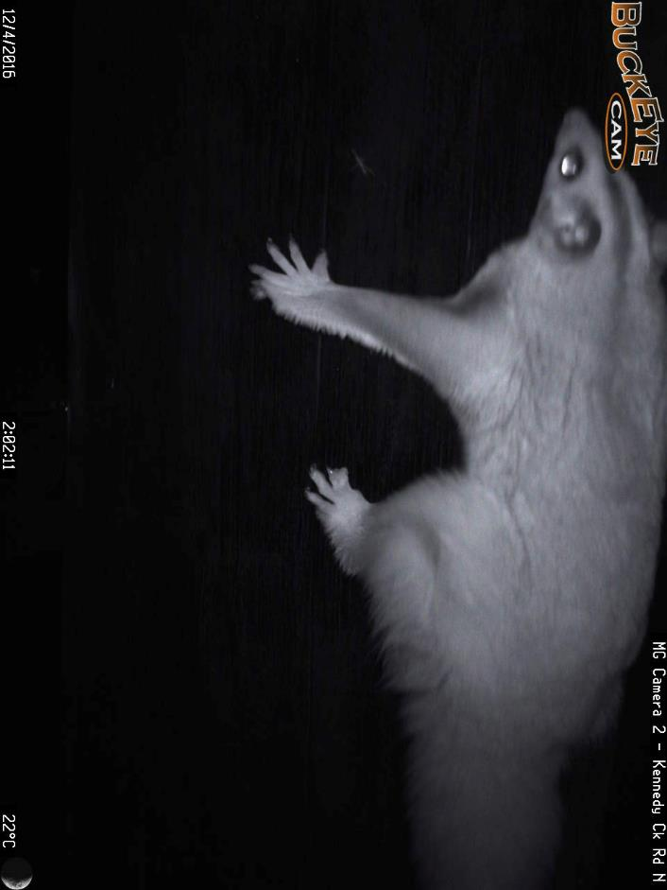
Camera monitoring images

Slide 15
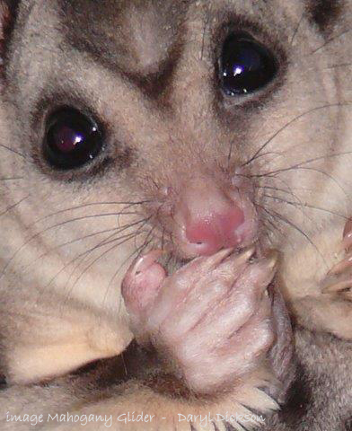
We need your help
talk about wildlife
share your interest
make contact with your local Wildlife Qld group
ask to be put on their contact list
follow our facebook pages & websites to find out what’s happening
every one of us can make a difference
every contribution is valuable

Slide 16
Species recovery
National Mahogany Glider Recovery Team
Established to guide the recovery of this species. Made up of stakeholders from a wide variety of organisations – WPSQ Cassowary Coast-Hinchinbrook chair this team. Draft new National Mahogany Glider Recovery Plan https://www.environment.gov.au/biodiversity/threatened/recovery-plans/comment/draft-recovery-plan-mahogany-glider
Worked with Terrain NRM to produce Mahogany Glider Story Map – ongoing projects and research about the mahogany glider. https://terrainnrm.maps.arcgis.com/apps/MapSeries/index.html?appid=fa79a361f4be4706acb9ce0ccbc14dfe

Slide 17
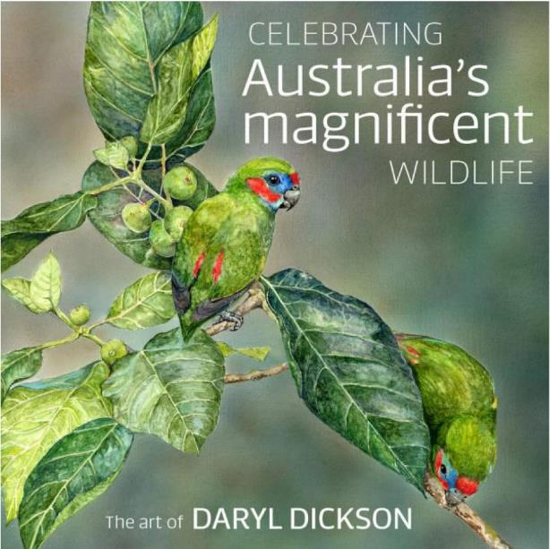
Interesting links
Rediscovering the mahogany glider : ABC Podcast Dr Steve Van Dyck http://www.abc.net.au/local/stories/2009/05/01/2558194.htm
Check out our Mahogany Glider Story Map – video – mapping - information
Celebrating Australia’s Magnificent Wildlife – the Art of Daryl Dickson
Book release October 2020

Slide 18
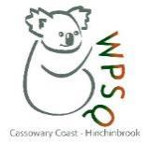
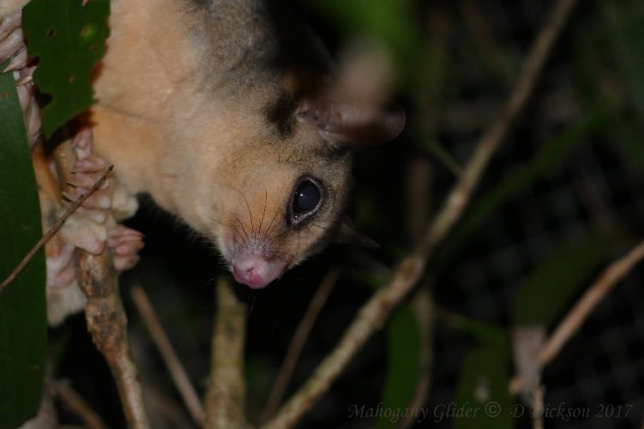
Website
https://wildlife.org.au/cassowary-coast/
https://wildlife.org.au/townsville/
Facebook https://www.facebook.com/Wildlife-Queensland-Cassowary-Coast-Hinchinbrook-280827565336753

